Slide 1
IT PROJECT MANAGEMENT
Lecture 3
Project Portfolio Management
2022

Slide 2
Objectives
Project Portfolio Management
Importance of people skills and leadership
Ethics in Project Management

Slide 3
Project Portfolio Management
In many organizations, project managers also support an emerging business strategy of project portfolio management or portfolio management,
Organizations group and manage projects and programs as a portfolio of investments that contribute to the entire enterprise’s success.

Slide 4
Project Portfolio Management
Portfolio managers help their organizations make wise investment decisions by helping to select and analyze projects from a strategic perspective.
Portfolio managers may or may not have previous experience as project or program managers.
It is most important that they have strong financial and analytical skills and understand how projects and programs can contribute to meeting strategic goals.

Slide 5
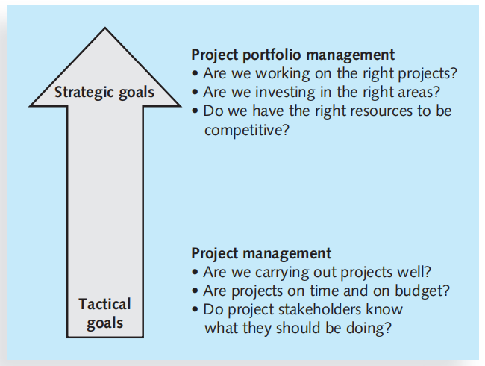
Project management compared Project Portfolio Management
Long-term goals
Individual project often
Address strategic goal
Generally more specific
Short-term goal
Individual project often
Address Tactical goal

Slide 6
Project Portfolio Management
Project management addresses questions like
“Are we carrying out projects well?”,
“Are projects on time and on budget?”, and
“Do project stakeholders know what they should be doing?”

Slide 7
Project Portfolio Management
Portfolio management addresses questions like
“Are we working on the right projects?”,
“Are we investing in the right areas?”, and
“Do we have the right resources to be competitive?”

Slide 8
Project Portfolio Management
Pacific Edge Software’s product manager, Eric Burke, defines project portfolio management as “the continuous process of selecting and managing the optimum set of project initiatives that deliver maximum business value.”

Slide 9
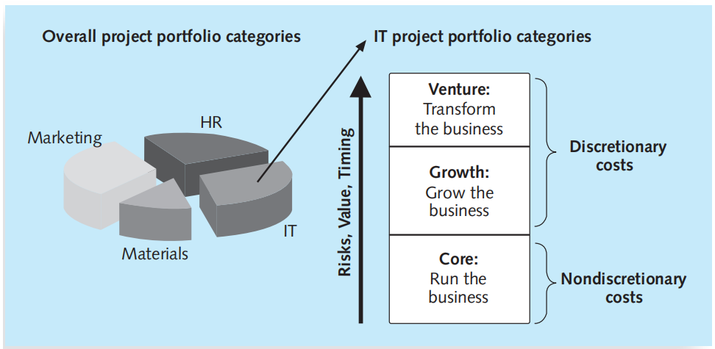
Project Portfolio Management
Project portfolio management is not an easy task
In this project portfolio management there is one large portfolio in the entire organization.
This allows top management to view and manage all projects at an enterprise level.

Slide 10
Project Portfolio Management
Sections of the portfolio are then broken down to improve the management of projects in each sector.
For example, a company might have the main portfolio categories such as materials, IT, and human resources (HR)—and divide each of those categories further to address its unique concerns.
The IT projects shows how it could be categorized in more detail to assist in their management.
In this example, there are three basic IT project portfolio categories:
Venture,
Growth, and
Core

Slide 11
Project Portfolio Management
Venture: Projects in this category help transform the business. This project could help transform the business by developing closer partnerships with customers and suppliers.
Growth: Projects in this category would help the company increase its revenues. This capability could help the company grow its business in those countries.
Core: Projects in this category must be accomplished to run the business. For example, an IT project to provide computers for new employees.

Slide 12
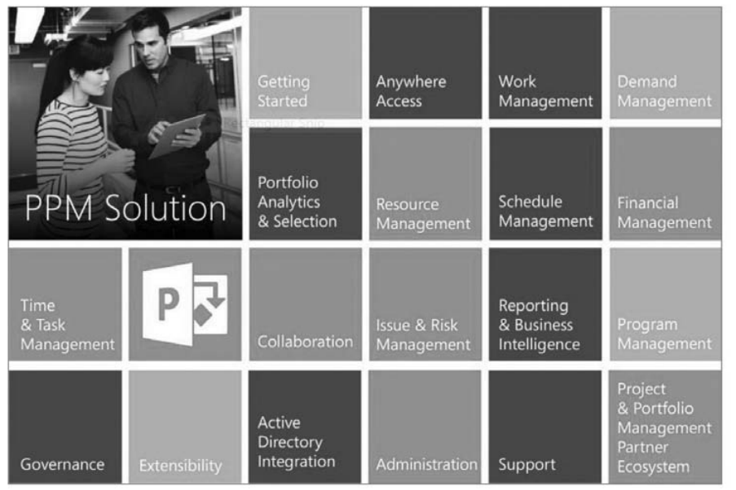
Project Portfolio Management Capabilities

Slide 13
Importance of People Skills and Leadership Skills
Project management experts from various industries were asked to identify the 10 most important skills and competencies for effective project managers.

Slide 14
Skills for Project Managers
Project managers need to have a wide variety of skills and be able to decide which skills are more important in different situations.
The Project Management Body of Knowledge
Application area knowledge, standards, and regulations
Project environment knowledge
General management knowledge and skills
Soft skills or human relations skills

Slide 15
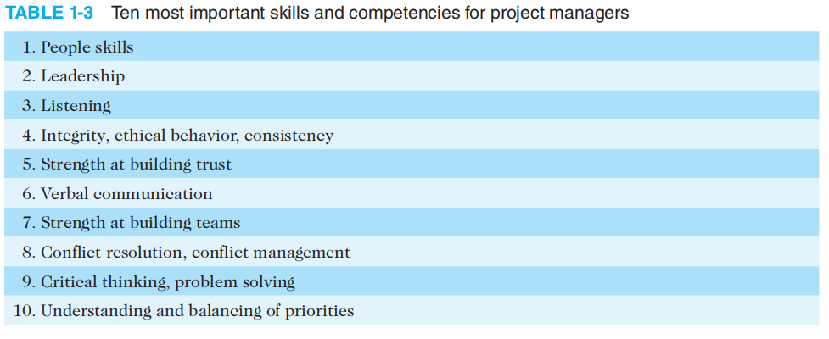
Importance of People Skills and Leadership Skills

Slide 16
Importance of People Skills and Leadership Skills
Respondents were also asked what skills and competencies were most important in various project situations:
Large projects: Leadership, relevant experience, planning, people skills, verbal communication, and team-building skills were most important.
High-uncertainty projects: Risk management, expectation management, leadership, people skills, and planning skills were most important.
Innovative projects: Leadership, people skills, vision- and goal-setting, self-confidence, expectations management, and listening skills were most important.

Slide 17
Ethics Project Management
Ethics, loosely defined, is a set of principles that guides decision making based on personal values of what is considered right and wrong.
Making ethical decisions is an important part of project managers’ personal and professional lives because it generates trust and respect with other people.

Slide 18
Ethics Project Management
Project managers often face ethical dilemmas.
If project managers can make more money by taking bribes, should they? No!
Should project managers accept subpar work to meet a deadline? No!
Ethics guide us in making these types of decisions.

Slide 19
Ethics Project Management
PMI approved a Code of Ethics and Professional Conduct that took effect in January 2007.
It is vital for project management practitioners to conduct their work in an ethical manner.
Even if you are not affiliated with PMI, these guidelines can help you conduct your work in an ethical manner, which helps the profession earn the confidence of the public, employers, employees, and all project stakeholders.
The PMI Code of Ethics and Professional Conduct includes short chapters addressing vision and applicability, responsibility, respect, fairness, and honesty

Slide 20
Ethics in Project Management
We make decisions and take actions based on the best interests of society, public safety, and the environment.
We accept only those assignments that are consistent with our background, experience, skills, and qualifications.
We fulfill the commitments that we undertake—we do what we say we will do.
We inform ourselves about the norms and customs of others and avoid engaging in behaviors they might consider disrespectful.
We listen to others’ points of view, seeking to understand them.
We approach directly those persons with whom we have a conflict or disagreement.

Slide 21
Ethics in Project Management
We demonstrate transparency in our decision-making process.
We constantly reexamine our impartiality and objectivity, taking corrective action as appropriate.
We proactively and fully disclose any real or potential conflicts of interest to appropriate stakeholders.
We earnestly seek to understand the truth.
We are truthful in our communications and in our conduct.”

